Slide 1
CineReview
Movie Review Web Application
CST8326 Web Programming · Group 40
Boris Gueye · Nahoum Legesse · Ruoyu Gong · Michel Lienou Zeitcheu

Slide 2
What We Built
CineReview is a website where users can browse and review movies. Built with Node.js, Express, MongoDB Atlas, and Pug templates.
🔐
🎬
⭐
📋
Register & Login
Browse & Filter
Write Reviews
Dashboard
Create an account and log in
Search by title or filter by genre
Rate movies 1–5 stars and share your thoughts
Manage and edit all your reviews in one place

Slide 3
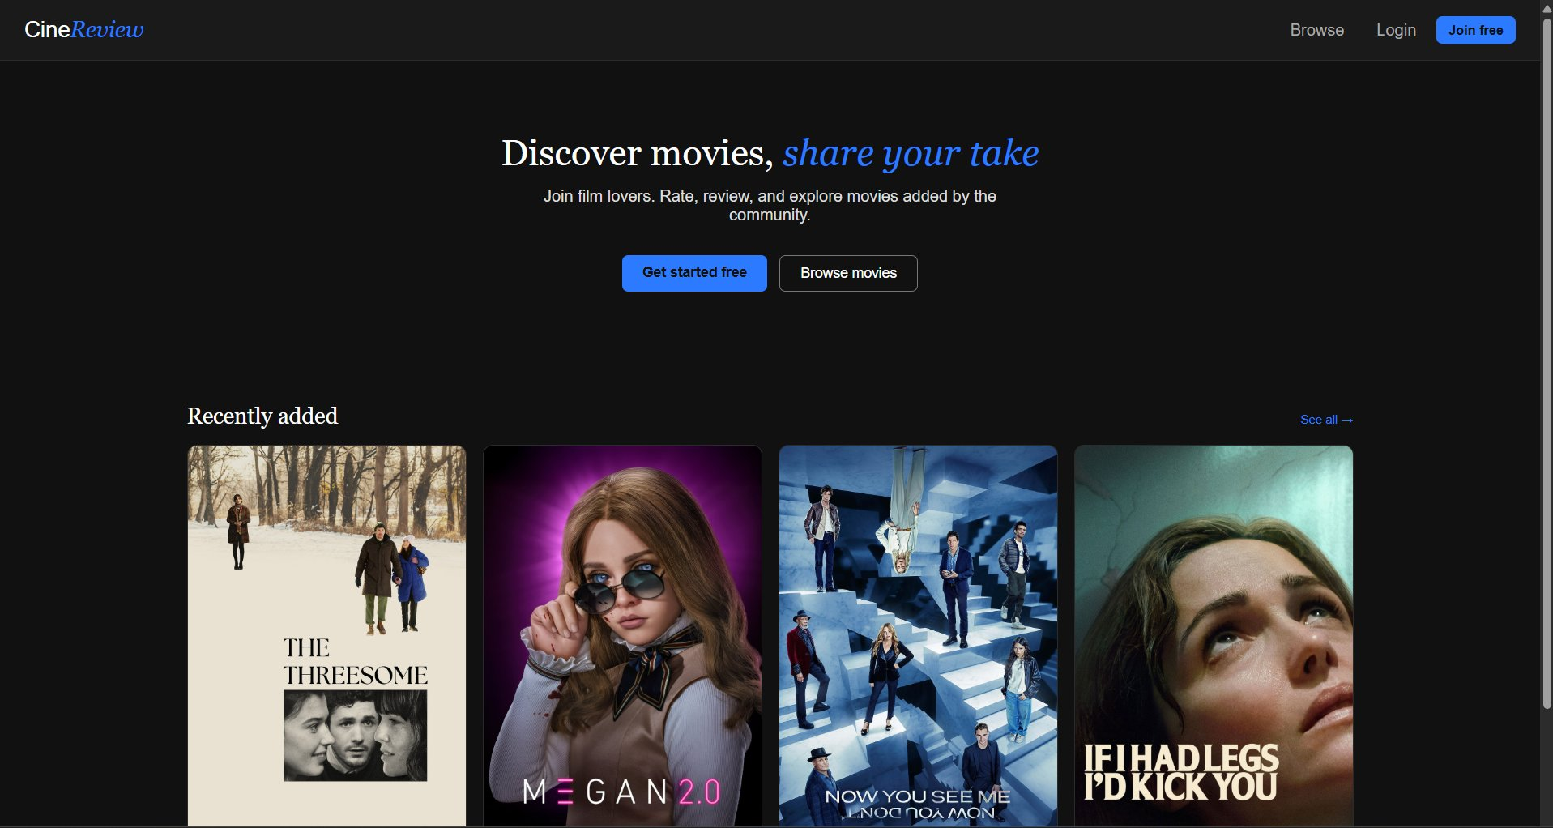
Homepage
Clear starting point for users to either browse or sign up
Shows recently added movies
Simple, easy to navigate layout
Navigation bar keeps main actions accessible

Slide 4
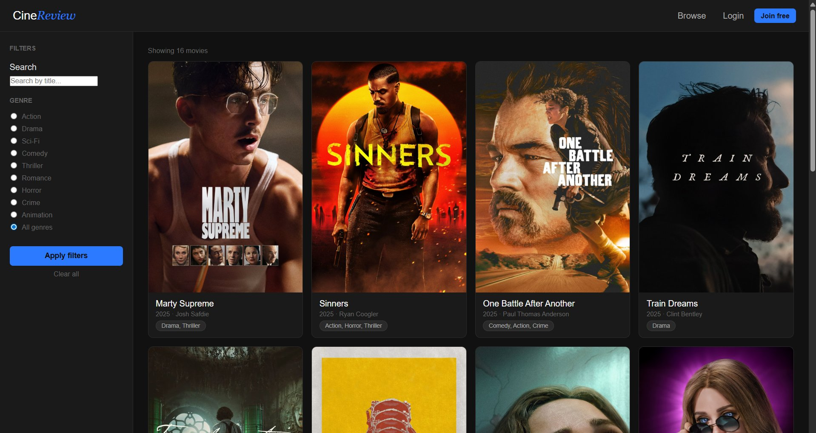
Browse Movies
Grid-based layout for easy browsing of multiple movies
Search movies by title
Filter movies by genre
Dynamic results update based on user input

Slide 5
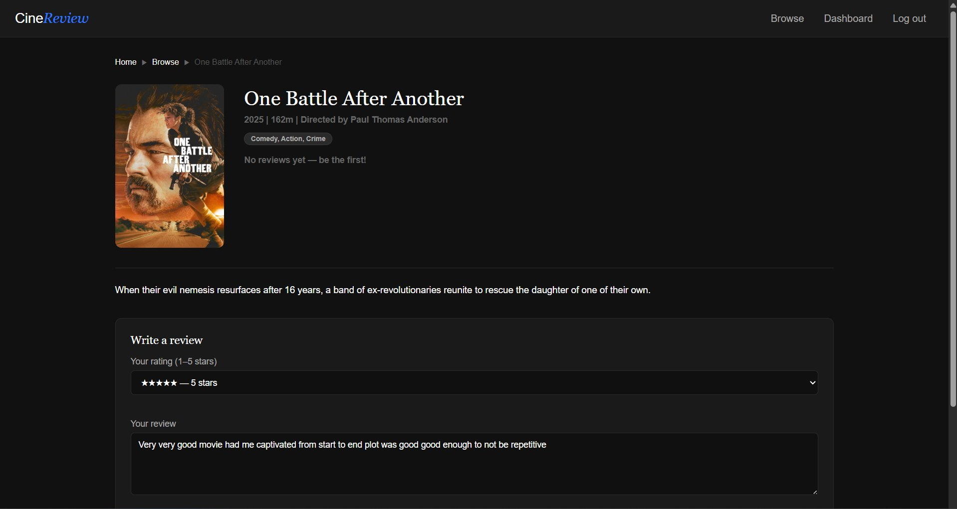
Movie Detail Page
View detailed information about each movie
Users can rate movies and share their thoughts
Edit or delete reviews
See reviews from other users

Slide 6
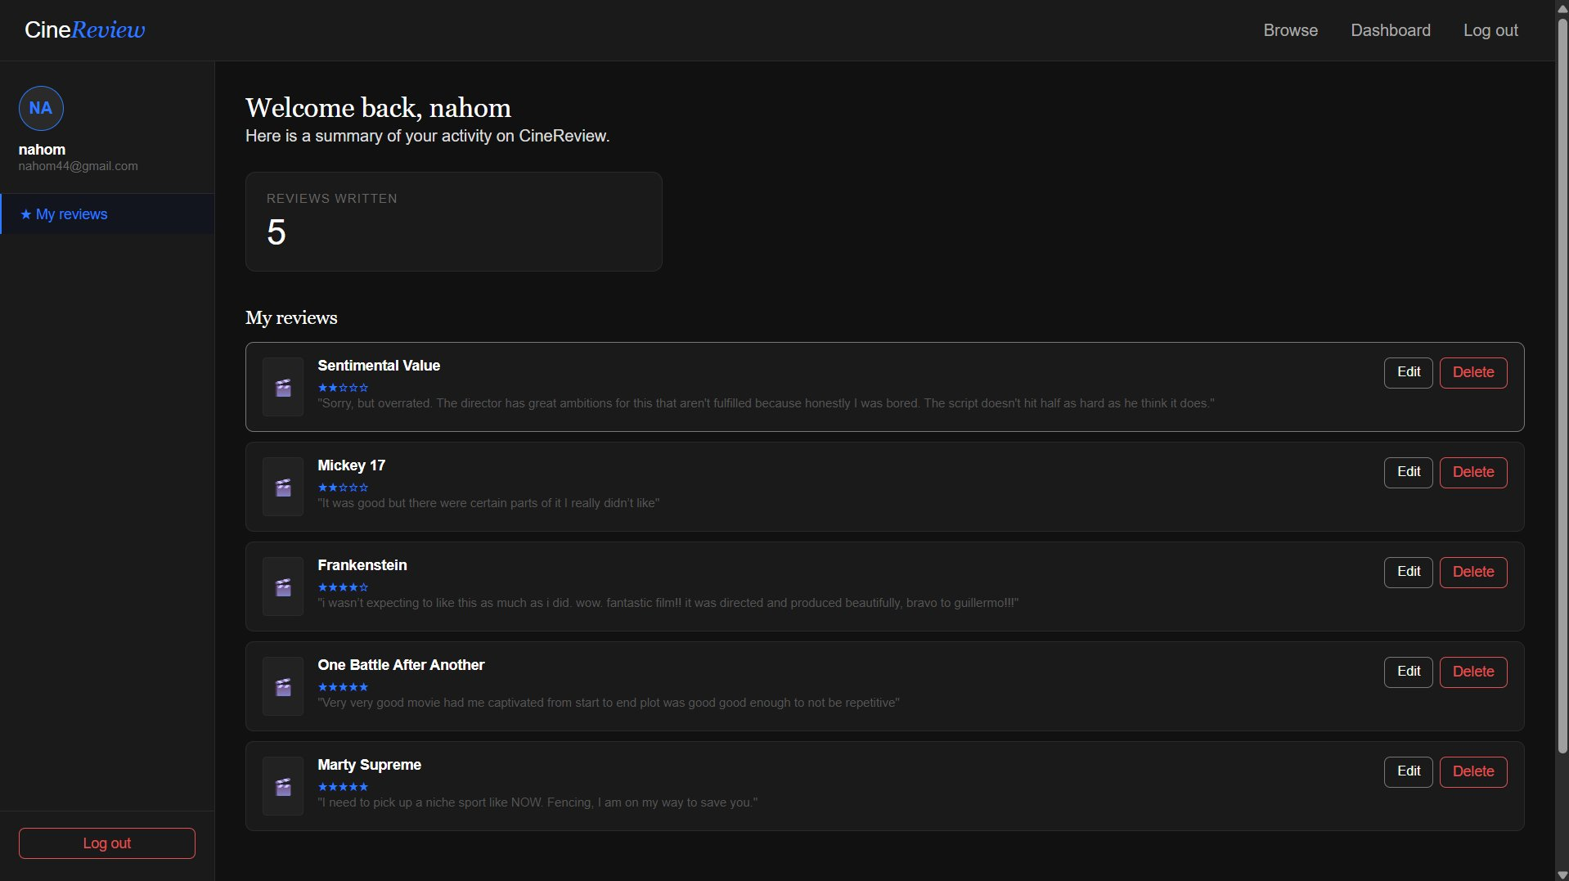
User Dashboard
Personalized dashboard with user information
View all submitted reviews in one place
Edit or delete reviews
Quick overview of your review activity

Slide 7
Thank You
CineReview
Nahom Legesse · Boris Gueye · Ruoyu Gong · Michel Lienou Zeitcheu

